Slide 1
IV Semester
BSCPHC 281: Electricity & X-ray Crystallography
Unit-I: Transients & DC Networks Transient Currents:
Theory of CR circuit (charging and discharging) –LR circuit (growth and decay), LCR circuit (discharging). Network theorems: Superposition theorem, Thevenin’s & Norton’s theorems. Maximum power transfer theorem (derivation), some applications. Problems.
Unit-II: Alternating Currents & Filters Alternating currents:
Expression for the RMS value of voltage and currents, j operator principles of superposition and phasor analysis. Response of LR, CR and LCR circuit to sinusoidal voltages using j operators. Series and parallel resonance circuits – expression for the ‘Q’ factor, bandwidth – expression for the power.
Filters: High and low pass filters using CR and LR circuits, frequency response curves, cutoff frequency, qualitative study of band pass filters. Problems.

Slide 2
Unit-III: Electrical & Magnetic Measurements
Force acting on a moving charge in electric and magnetic fields - Lorentz force. Force on a current carrying conductor in a magnetic field. Torque on a current loop in a magnetic field. Magnetic dipole moment – Torque on a magnetic dipole. Equivalence of a current loop and a magnetic dipole.
Ballistic galvanometer – charge sensitivity – effect of damping. Applications of B.G. Determination of capacitance by absolute - determination of high resistance by leakage. Theory of Andersons bridge & De-Sauty’s bridge. Problems.
Unit-IV: X-ray Crystallography & Superconductivity X- ray crystallography:
production of X-rays. Coolidge tube. Continuous and characteristic X-ray spectra. Moseley’s law. Definition of a lattice, unit cell, seven crystal systems. Miller indices, Bragg’s law. Bragg’s spectrometer, structure of NaCl and KCl.
Superconductivity: Elementary ideas – experimental facts, transition temperature, critical field, critical current, Meissner effect. High temperature superconductivity. Applications of superconductivity – production of high magnetic field. Problems.

Slide 3
Books for reference:
Electricity and magnetism – E M Purcell, Cambridge University Press, 2013
Elements of Electromagnetism – Mathew and N O Sadiku, Oxford University Press, 2018
Introductory to Circuit Analysis – Robert Boylested, Pearson Education India, 2007
Electricity and magnetism – D C Tayal, Himalaya Publishing House, 1989
Elements and magnetism – Tareja, Springer New York, 2014
Elements of X- ray diffraction – Cullity & Stock, Addison-Wesley Publishing Co. 1978
Solid state Physics – H C Guptha, Vikas Publishing House Pvt Limited, 2001
Elementary Solid state Physics – Ali Omer, Pearson Education India, 1975
Modern Physics by R. Murugeshan and Kiruthiga Sivaprasath, S Chand, 2010

Slide 4
Question paper pattern for III & IV semester
Internal Assessment: 20 marks
Semester Examination 80 marks
Questions carrying 1 mark 8 out of 10 1 x 8 = 8 marks
Questions carrying 2 mark 6 out of 8 2 x 6 = 12 marks
UNIT I,II, III &IVInternal choice for each unit
Questions carrying 1 x 4 = 4
1 x 6 = 6
Problem 1 x 5 mark
Total 15 x 4 = 60

Slide 19
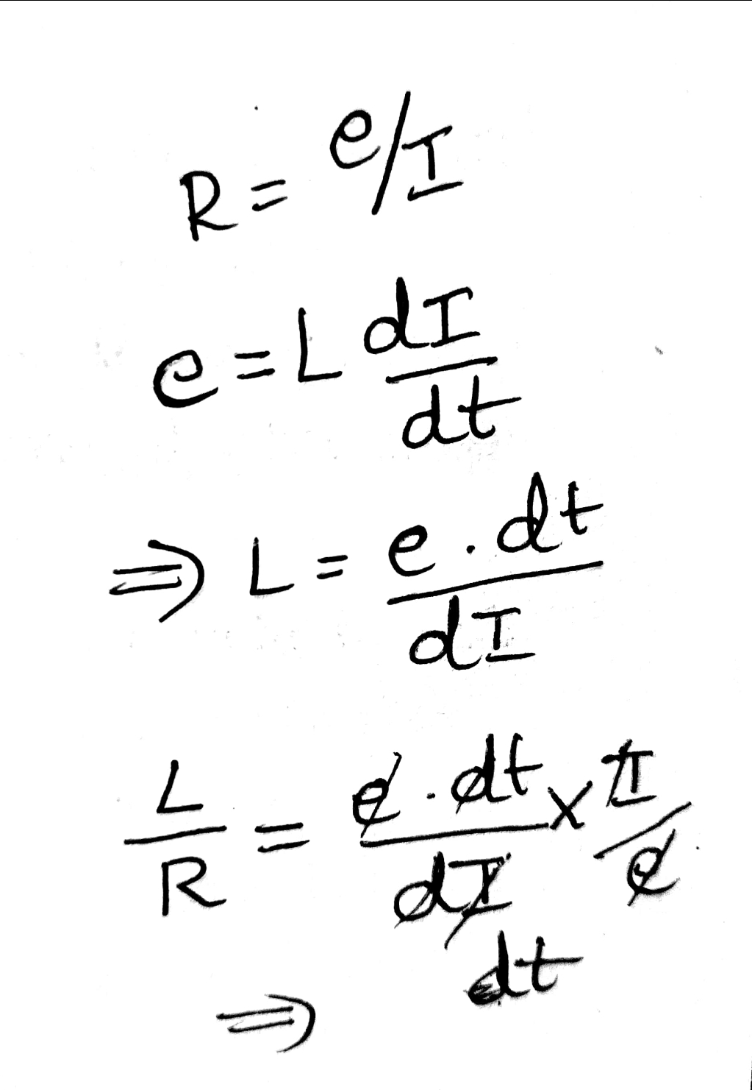

Slide 31
